Slide 1


CAPSTONE PROJECT
CALL CENTER ANALYTICS DASHBOARD
Presented By
Student Name: Nitumoni Deka
College Name: Acharya institute of technology
Department: Information science and engineering
Email ID: Nitumonij.20.beis@acharya.ac.in

Slide 2
OUTLINE:
Problem Statement (Should not include solution)
Proposed System/Solution
System Development Approach (Technology Used)
Algorithm & Deployment
Result (Output Image)
Conclusion
Future Scope
References

Slide 3
Problem Statement:
Organizations with call centers receive thousands of customer calls daily.
However, tracking performance manually is difficult.
There is a need to monitor:
- Total number of calls
- Call duration
- Agent efficiency
- Response time performance
Without proper dashboards, decision-making becomes slow and inefficient.

Slide 4
Proposed Solution:
Develop an interactive Call Center Dashboard using Power BI.
The dashboard will:
- Track total calls
- Monitor call duration (minutes & hours)
- Show average call duration
- Analyze response time percentage
- Provide insights by state, reason, and sentiment
This helps managers take quick and data-driven decisions.

Slide 5
System Approach:
Tools Used:
- Power BI
- Excel / CSV Dataset
Steps:
1. Data Collection
2. Data Cleaning
3. Data Modeling
4. Dashboard Creation

Slide 6
Algorithm & Deployment:
Basic Data Analysis Techniques used:
- Aggregation (SUM, COUNT)
- Average Calculation
- Percentage Calculation
DAX Functions used in Power BI for metrics.
KPIs Implemented:
1. Total Number of Calls
2. Total Call Duration (Minutes & Hours)
3. Average Call Duration
4. Response Time Percentage

Slide 7
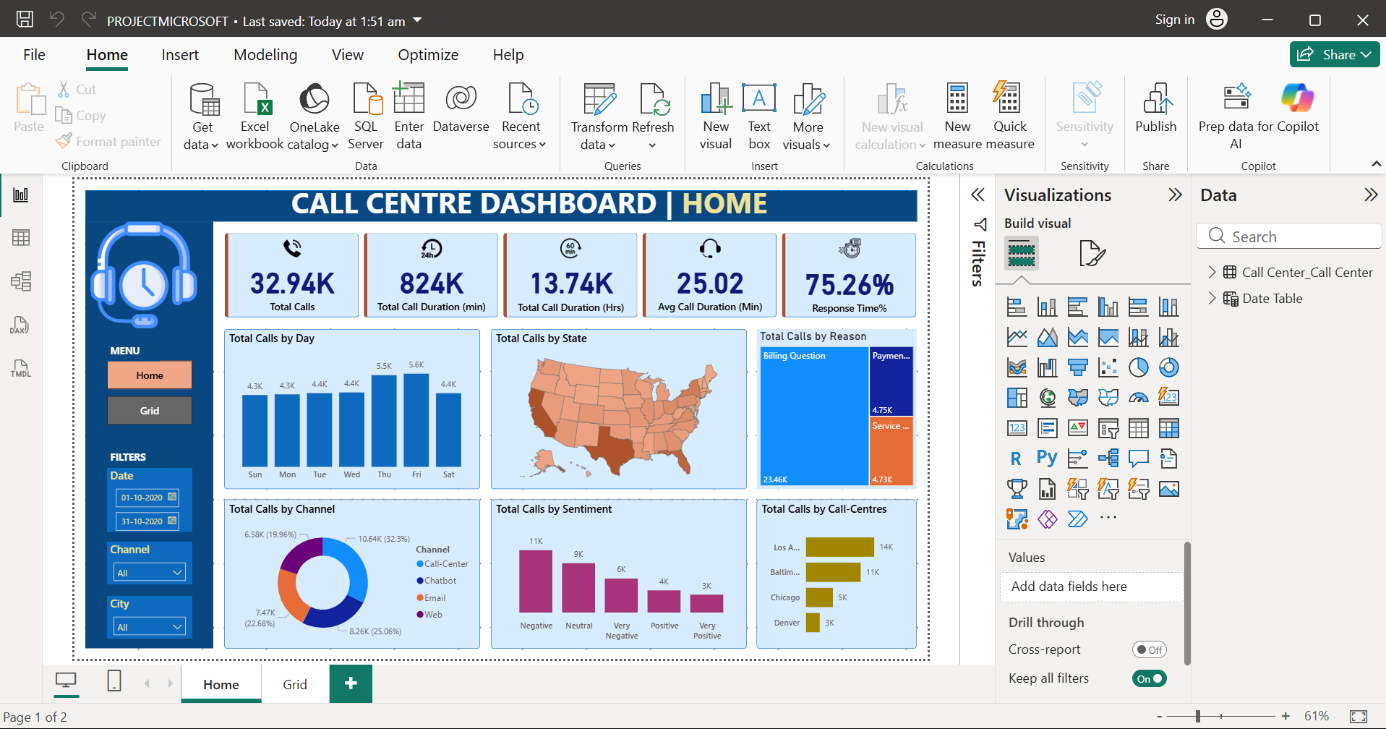
Result:
The dashboard successfully visualizes call center performance.
Insights include:
- Call trends by day
- Calls by state
- Call reasons
- Customer sentiment

Slide 8
Conclusion:
The Call Center Dashboard developed using Power BI provides a clear and interactive view of call center performance.
It helps in tracking important KPIs such as total number of calls, call duration, average handling time, and response time percentage.
Through visualizations like charts and maps, the dashboard makes it easier to identify trends, customer behavior, and operational efficiency.
Overall, this project demonstrates how data analytics can improve decision-making, enhance productivity, and optimize customer service performance in an organization.

Slide 9
Future scope:
This project can be further enhanced in several ways:
- Integration of real-time data to monitor live call center performance
- Use of machine learning models to predict call volumes and customer behavior
- Adding advanced filters and drill-down features for deeper analysis
- Integration with CRM systems for better customer insights
- Development of a web-based dashboard for wider accessibility
These improvements can make the system more powerful, scalable, and useful for large organizations.

Slide 10
References:
GitHub Repository:
Link: https://github.com/nitumoni01-design/call-center-dashboard.git

Slide 11
Thank You

